Slide 1
Review: while Loop
while (condition){
statement1-1;
… …
statement1-n;
}
statement2;
Syntax of while loops
#1: Repeat a task a finite number of times
#2: Repeat a task indefinitely until a condition is met
Using repetition to solve problems
Statistics: sum, average, maximum, minimum, etc.
loop variable initialization
looping condition
loop condition change
loop body

Slide 2
Example: Read in 5 integers
1
2
3
4
5
6
7
int A[5];
printf("Enter 5 #'s: ");
int i = 0;
while (i < 5) {
scanf("%d",&A[i]);
i++;
}
loop variable initialization,
looping condition,
loop condition change, and
loop body?
Common mistakes and infinite loops
while(true)
Forget to update i

Slide 3
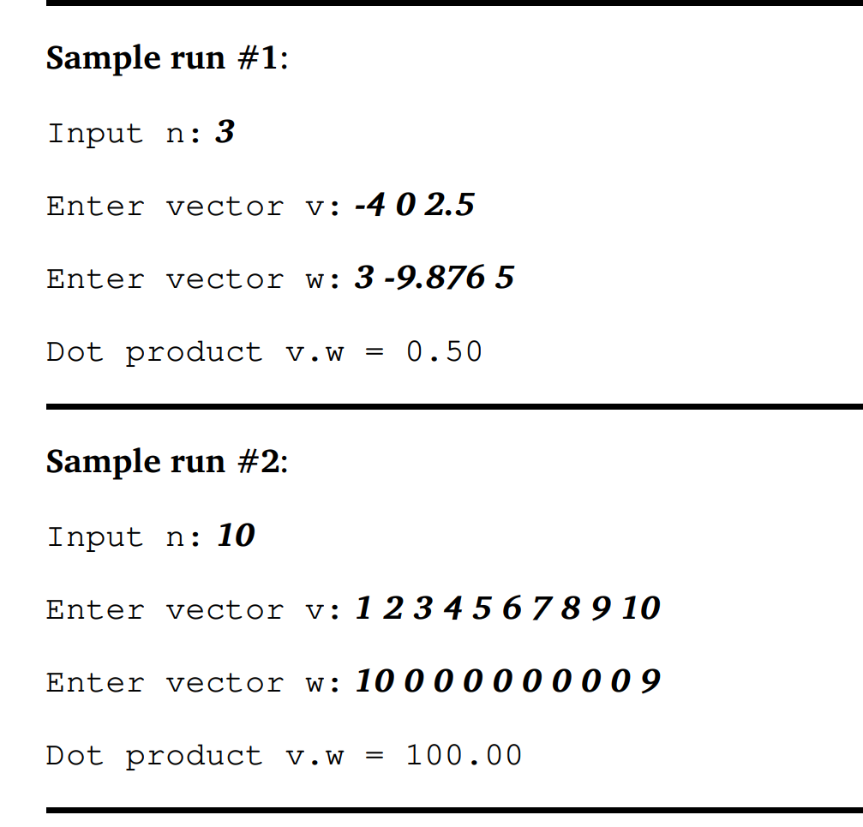
Common problems in Lab5 Ex6
Lab-5 Ex6 - High Dimension Dot-Product
int n;
double v[n],w[n];
…
Any problem in the above code?

Slide 4
Looping (II) for Loop generally help us do finite repetition

Slide 5
Outline
for statement
Further Examples on Array Processing
More For-Loop Examples

Slide 6
0. for-loop vs. while-loop
They are "equivalent" in terms of what you can accomplish with them.
Any task you can accomplish with one of these loop structures, you can also accomplish the task with the other loop structure.
for-loop is more expressive for tasks to be repeated a finite number of times, i.e. finite repetition.
init;
while (condition){
statement1-n;
update;
}
statement2;
for (init; condition; update){
statement1-n;
}
statement2;

Slide 7
1. for statement (Syntax)
for (init; condition; update){
statement1-n;
}
statement2;
The initialization (init) statement
Executes once before the condition statement.
The condition statement
is the same as in the while-loop condition.
The loop body (statement1-n)
Repeats until the condition statement becomes false.
The update statement
Executes after statement1 in each iteration, and
is usually for updating the loop condition.
init
update
condition
true
Statement1-n
false
statement2

Slide 8
1.1. for Statement (Example #1)
for (init; condition; update){
statement1-n;
}
statement2;
1
2
3
4
5
6
7
8
9
int i;
// A simple loop that iterates 5 times
for (i = 1; i <= 5; i++) {
printf("%d\n", i);
}
printf("Lastly, i = %d\n", i);
loop variable initialization
looping condition
Update
loop body
1
2
3
4
5
Lastly, i = 6
init
update
condition
true
Statement1-n
false
statement2

Slide 9
1.1. for-loop vs. while-loop
initialization
looping condition
update
While-Loop Version
1
2
3
4
5
6
7
int i;
i = 1;
while (i <= 5) {
printf("%d\n", i);
i++;
}
For-Loop Version
1
2
3
4
5
int i;
for (i = 1; i <= 5; i++) {
printf("%d\n", i);
}
Comparison
"equivalent"

Slide 10
1.2. Example #2 – Multiple ways of writing a for loop
Task: Print numbers from N to 1.
e.g. N=4 Solution
Output:
4
3
2
1
1
2
3
4
5
6
int i, N;
scanf("%d", &N);
// i decreases from N to 1
for (i = N; i >= 1; i--) {
printf("%d\n", i);
}

Slide 11
1.2. Example #2 – Multiple ways of writing a for loop
Different ways to output numbers from N to 1 using a for loop.
According to different initialization, the condition, update and loop body can be different accordingly.
Task: Print numbers from N to 1.
e.g. N=4 Solution 2
Output:
4
3
2
1
1
2
3
4
5
6
7
int i, num, N;
scanf("%d", &N);
// i increases from 1 to N
for (i = 1; i <= N; i++) {
num = ??? ;
printf("%d\n", num);
}
Ureply
Find the relation between i and output

Slide 12
2.1. Example #3: Arrays and for loop
We usually use for loops to process array elements.
Array size -> number of iterations
Loop variable -> array index
1
2
3
4
5
int list[4], i;
printf("Enter 4 #'s: ");
for (i = 0; i < 4; i++)
scanf("%d", &list[i]);

Slide 13
2.1. Example #3: Arrays and for loop
1
2
3
4
5
6
7
8
9
10
11
int list[4], i;
printf("Enter 4 #'s: ");
for (i = 0; i < 4; i++)
scanf("%d", &list[i]);
// Print the input values in reverse order
printf("You have entered:");
for ( i = 3; i >= 0; i-- )
printf("%d", list[ i ]);
printf("\n");
Task: read in a list of number and print them out in reverse order
Enter 4 #'s: 7 11 45 23
You have entered: 23 45 11 7
Note: Input values can be separated by any white space character.

Slide 14
2.1. Example #3: Arrays and for loop
1
2
3
4
5
6
7
8
9
10
11
int list[4], i;
printf("Enter 4 #'s: ");
for (i = 0; i < 4; i++)
scanf("%d", &list[i]);
// Print the input values in reverse order
printf("You have entered:");
for ( i = 0; i < 4; i++ )
printf("%d", list[ 4 – i – 1 ]);
printf("\n");
Task: read in a list of number and print them out in reverse order
???4-1-i
Enter 4 #'s: 7 11 45 23
You have entered: 23 45 11 7
Note: Input values can be separated by any white space character.
Find the relation between i and index

Slide 15
2.2. A Common Mistake
Typical cause of array out-of-bound exception when using arrays in a for-loop:
int A[10], i;
for ( i = 0; i <= 10; i++ )
A[i] = i;
Remember, the index of an array element ranges from 0 to “array size - 1”!
i < 10

Slide 16
2.3 Further Examples on Array Processing
The following few slides are some examples illustrating how we can process data in arrays using for loops. The examples include:
Tasks:
Reading N numbers from the user and store the numbers in an array
Computing average of all the numbers in an array
Finding the largest value in an array

Slide 17
Reading N numbers and store the numbers in an array
1
2
3
4
5
6
7
8
9
10
int N, // # of data
num[100], // To store up to 100 numbers
i;
printf("# of data:");
scanf("%d", &N); // Assuming 1 <= N <= 100
for ( i = 0; i < N; i++ )
scanf("%d", &num[ i ] );
Example 4: Read N integers (N <= 100) from the user and store the integers in the array num[].

Slide 18
Computing average of all the numbers in an array
1
2
3
4
5
6
7
8
9
10
11
// Suppose num[] contains N numbers.
// (Please refer to Example 4 for the code)
double sum;
sum = 0.0;
for ( i = 0; i < N; i++ )
sum += num[ i ];
printf("Average = %.2f\n", sum / N);
Example 5. Computing the average of the numbers in an array.

Slide 19
Finding the largest value in an array
1
2
3
4
5
6
7
8
9
10
11
12
13
// Suppose num[] contains N numbers.
// (Please refer to Example 4 for the code)
int max;
max = num[0]; // Assume the 1st element is largest
for ( i = 1; i < N; i++ ) {
// Update max if we encounter a larger value
if (num[i] > max)
max = num[i];
}
printf("The largest # is %d\n", max);
Example 6: Finding the largest number in an array.

Slide 20
int N, num[100], i;
printf("# of data:");
scanf("%d", &N); // Assuming 1 <= N <= 100
for ( i = 0; i < N; i++ )
scanf("%d", &num[ i ] );
double sum= 0.0;
for ( i = 0; i < N; i++ )
sum += num[ i ];
printf("Average = %.2f\n", sum / N);
int max= num[0]; // Assume the 1st element is largest
for ( i = 1; i < N; i++ ) {
if (num[i] > max) // Update max if we encounter a larger value
max = num[i];
}
printf("The largest # is %d\n", max);
Read in
Average
Max
Three loops

Slide 21
Read N numbers, Compute average, Find the largest value
1
2
3
4
5
6
7
8
9
10
11
12
13
14
15
16
17
int N, num[100],i;
printf("# of data:");
scanf("%d", &N); // Assuming 1 <= N <= 100
scanf("%d", &num[ 0 ]);
double sum=0;
int max= num[0]; // Assume the 1st element is largest
for ( i = 1; i < N; i++ ) {
scanf("%d", &num[ i ]);
sum += num[ i ];
if (num[i] > max) // Update max if we encounter a larger value
max = num[i];
}
printf("Average = %.2f\n", sum / N);
printf("The largest # is %d\n", max);
Combine the three loops into one loop
Example 4,5, 6: Read N numbers, Compute average, Find the largest value

Slide 22
3. More For-Loop Examples
For-loops can be used in solving many general problems that may not involve arrays.
A reminder though: it is usually NOT recommended to use them in indefinite repetitions.
Indefinite repetitions, meet conditions -> while loop
Finite repetitions, fix number -> for loop

Slide 23
Example #5
Objective: To output the first N numbers in the following number series:
1 -2 3 -4 5 -6 7 -8 9 -10 11 -12 …
Notice that these numbers follow the following pattern:
+ve -ve +ve -ve +ve -ve +ve -ve …
Odd +
Even -

Slide 24
Example #5: Solution
1
2
3
4
5
6
7
8
9
10
11
int i, N;
printf("N = ? ");
scanf("%d", &N);
for (i = 1; i <= N; i++) {
if (i % 2 == 1)
printf("%d ", i);
else
printf("%d ", -i);
}
+ve -ve +ve -ve +ve -ve +ve -ve …
Odd +
Even -

Slide 25
Example #6
Objective: To output the first N numbers in the following number series:
1 2 -3 -4 5 6 -7 -8 9 10 -11 -12 …
Notice that these numbers follow the following pattern:
+ve +ve -ve -ve +ve +ve -ve -ve …
and the pattern "+ve +ve -ve -ve" repeats after every four numbers.

Slide 26
Example #6: Solution
1
2
3
4
5
6
7
8
9
10
11
int i, N;
printf("N = ? ");
scanf("%d", &N);
for (i = 1; i <= N; i++) {
if ( )
printf("%d ", i);
else
printf("%d ", -i);
}
???
Ureply
+ve +ve -ve -ve +ve +ve -ve -ve …
The pattern "+ve +ve -ve -ve" repeats after every four numbers.

Slide 27
Example #7: Arrays and for loop
Here are five candidates for student president of one collage.
Now, 100 students are voting for them.
int President_Count[5] = { 0 };
Array
Index
Candidate1: David Johnson
0
[0]
Array to store the count for each candidates
At first, they are all ZERO
Candidate2: Jennifer Brown
0
[1]
Candidate3: James Miller
0
[2]
Candidate4: Jessica Martinez
0
[3]
Candidate5: Robert Anderson
0
[4]

Slide 28
Inportant Example #7: Arrays and for loop
1
2
3
4
5
6
7
8
9
10
11
12
13
14
15
16
17
18
int President_Count[5] = { 0 }; // All counts are set to 0
int voting; // To store user input, assuming valid
printf("Enter 100 students' ratings (1 to 5 stars): ");
// read 100 voting results
for (i = 0; i < 100; i++) {
scanf("%d", &voting);
// Map voting to 0 – 4, update President_Count[ ]
President_Count[voting-1]++;
}
printf(" Voting results\n");
for (i = 0; i < 5; i++)
printf(" Candidate %d: %d\n", i + 1, President_Count[i]);
Array
Index
Candidate1:
[0]
Candidate2:
[1]
Candidate3:
[2]
Candidate4:
[3]
Candidate5:
[4]

Slide 29
Arrays and for loop
Example #7
Array for counting
loop i=0, i<N
Find the input and index relation
Count[voting-1]++;
N is input size, input 100 votings
Output and i relation
Candidate i+1: count[i]
N is array size, 5 cantidates
Array
Index
Candidate1:
[0]
Candidate2:
[1]
Candidate3:
[2]
Candidate4:
[3]
Candidate5:
[4]
Similar but harder
Example #8

Slide 30
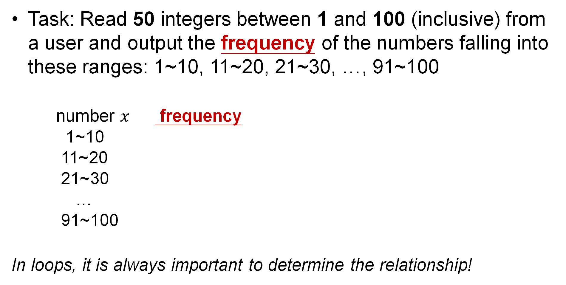
Example #8: Arrays and for loop (Hard)
Task: Read 50 integers between 1 and 100 (inclusive) from a user and output the frequency of the numbers falling into these ranges: 1~10, 11~20, 21~30, …, 91~100
number $x$ frequency
1~10
11~20
21~30
…
91~100
In loops, it is always important to determine the relationship!
Array
Array for count

Slide 31

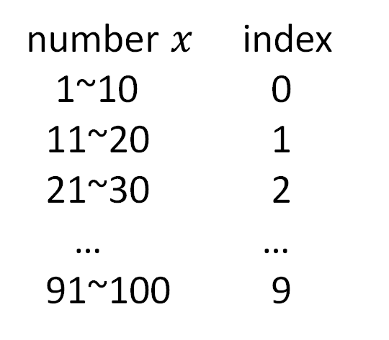
Example #8: Arrays and for loop (Hard)
Task: Read 50 integers between 1 and 100 (inclusive) from a user and output the frequency of the numbers falling into these ranges: 1~10, 11~20, 21~30, …, 91~100
In loops, it is always important to determine the relationship!
Given x, which freq[?]++
Find the relationship between number $x$ and index
number $x$ index
1~10 0
11~20 1
21~30 2
… …
91~100 9
Array
index = f(x)

Slide 32

Example #8: Arrays and for loop (Hard)
Task: Read 50 integers between 1 and 100 (inclusive) from a user and output the frequency of the numbers falling into these ranges: 1~10, 11~20, 21~30, …, 91~100
In loops, it is always important to determine the relationship!
Given x, which freq[?]++
Find the relationship between number $x$ and index
$$index=\frac{x}{10} ?$$
$$index=\frac{x−1}{10}$$
number $x$ index
1~10 0
11~20 1
21~30 2
… …
91~100 9
Array
index = f(x)
(note: integer
division)

Slide 33
Example #8: Arrays and for loop (Hard)
1
2
3
4
5
6
7
8
9
10
11
12
int freq[10] = { 0 }; // Initialize all elements to 0
int i, input, index;
for (i = 0; i < 50; i++) {
scanf("%d", &input);
// Assume all inputs are between 1 and 100 (inclusive)
index = (input – 1) / 10;
freq[ index ]++;
}

Slide 34
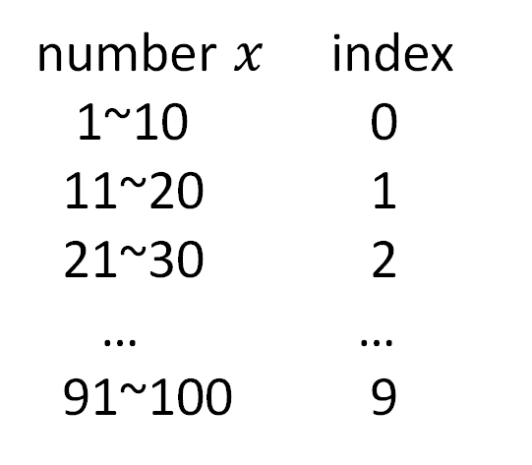
Example #8: Arrays and for loop (Hard)
Task: Read 50 integers between 1 and 100 (inclusive) from a user and output the frequency of the numbers falling into these ranges: 1~10, 11~20, 21~30, …, 91~100
In loops, it is always important to determine the relationship!
number $x$ index
1~10 0
11~20 1
21~30 2
… …
91~100 9
Array
Output:
Frequency of ??~???: Freq[i]

Slide 35
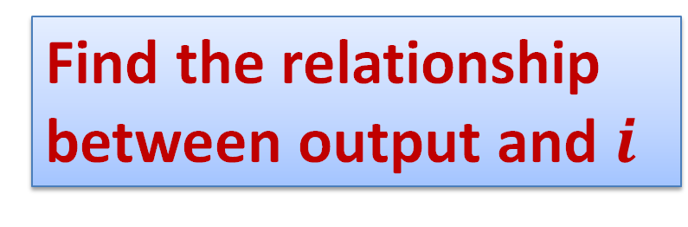
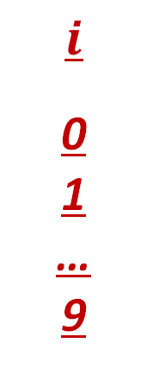
Example #8: Arrays and for loop (Hard)
Task: Read 50 integers between 1 and 100 (inclusive) from a user and output the frequency of the numbers falling into these ranges: 1~10, 11~20, 21~30, …, 91~100
In loops, it is always important to determine the relationship!
$$i$$
0
1
…
9
Output:
Frequency of ??~???: Freq[i]
Output:
Frequency of 1~10: Freq[0]
Frequency of 11~20: Freq[1]
…
Frequency of 91~100:Freq[9]
Find the relationship between output and $i$

Slide 36
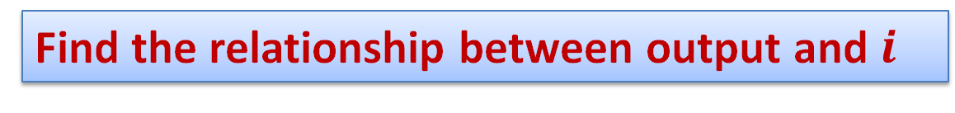
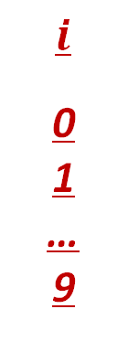
Example #8: Arrays and for loop (Hard)
Task: Read 50 integers between 1 and 100 (inclusive) from a user and output the frequency of the numbers falling into these ranges: 1~10, 11~20, 21~30, …, 91~100
In loops, it is always important to determine the relationship!
Find the relationship between output and $i$
$$i$$
0
1
…
9
Output:
Frequency of 1~10: Freq[0]
Frequency of 11~20: Freq[1]
…
Frequency of 91~100:Freq[9]
Output:
Frequency of ??~???: Freq[i]

Slide 37
Example #8: Arrays and for loop (Hard)
11
12
13
14
15
for (i = 0; i < 10; i++)
printf("Frequency of %d~%d: %d\n",
i*10 + 1, i*10 + 10, freq[i]);
Dry-running this loop…
i i*10+1 i*10+10 freq[i]
--------------------------------------------------
0 1 10 the count for 1~10
1 11 20 the count for 11~20
...
9 91 100 the count for 91~100

Slide 38
Example #8: Arrays and for loop (Hard)
1
2
3
4
5
6
7
8
9
10
11
12
13
14
15
int freq[10] = { 0 }; // Initialize all elements to 0
int i, input, index;
for (i = 0; i < 50; i++) {
scanf("%d", &input);
index = (input – 1) / 10;
// relationship between i and index
freq[ index ]++; // count frequence
}
for (i = 0; i < 10; i++)
printf("Frequency of %d~%d: %d\n",
i*10 + 1, i*10 + 10, freq[i]);
// relationship between i and output
Task: Read 50 integers between 1 and 100 (inclusive) from a user and output the frequency of the numbers falling into these ranges: 1~10, 11~20, 21~30, …, 91~100
Full Code

Slide 39
Summary
for (init; condition; update){
statement1-n;
}
statement2;
Syntax of for loops
Comparison of for loops and while loops
Combine Loops
For loop and Array
Relationship between i and index
While loop : Indefinite repetitions, meet some conditions
For loop : Finite repetitions, fix number

Slide 40
Reading Assignment
C: How to Program, 8th ed, Deitel and Deitel
Chapter 3 Structured Program Development in C
Sections 3.7 – 3.9
Chapter 4 C Program Control
Sections 4.1 – 4.6, 4.9

Slide 41
Midterm Exam 13 Oct (Next Monday)
Reminder:
Closed-book, closed-note, WRITTEN exam
Remember to bring your pen and other stationaries
More instruction will be mentioned this Thursday.

